Slide 1
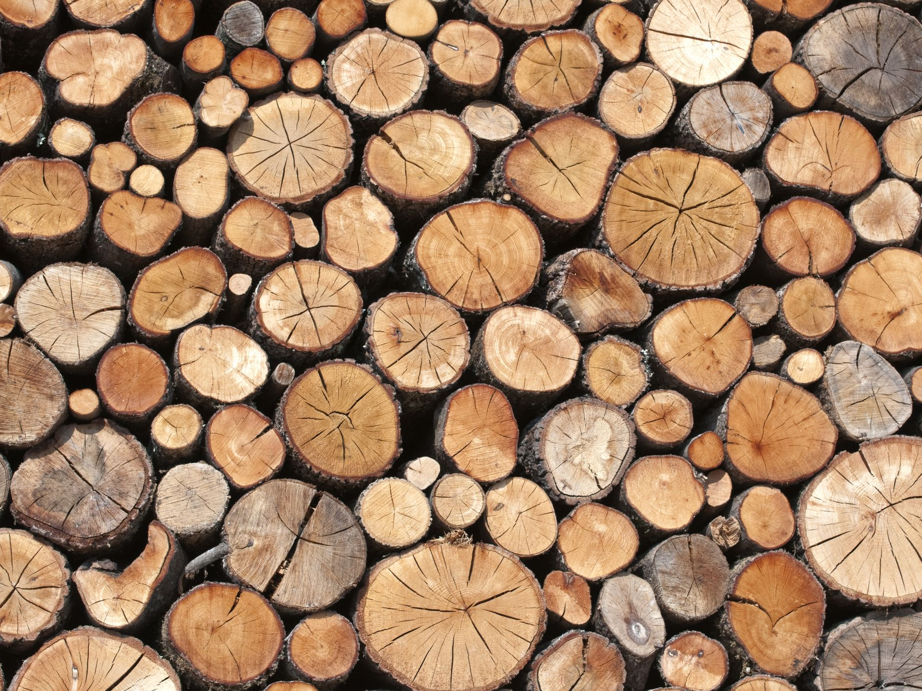
nat5 Design & Manufacture
Wood - Theory

Slide 2


Learning intentions & success criteria
Learning Intentions
Develop our understanding of woods, tools and manufacturing processes.
Success Criteria
I can name all the tools used in the wood workshop.
I can explain the different properties of wood.
I can name and explain the different manufacturing processes for wood.

Slide 3
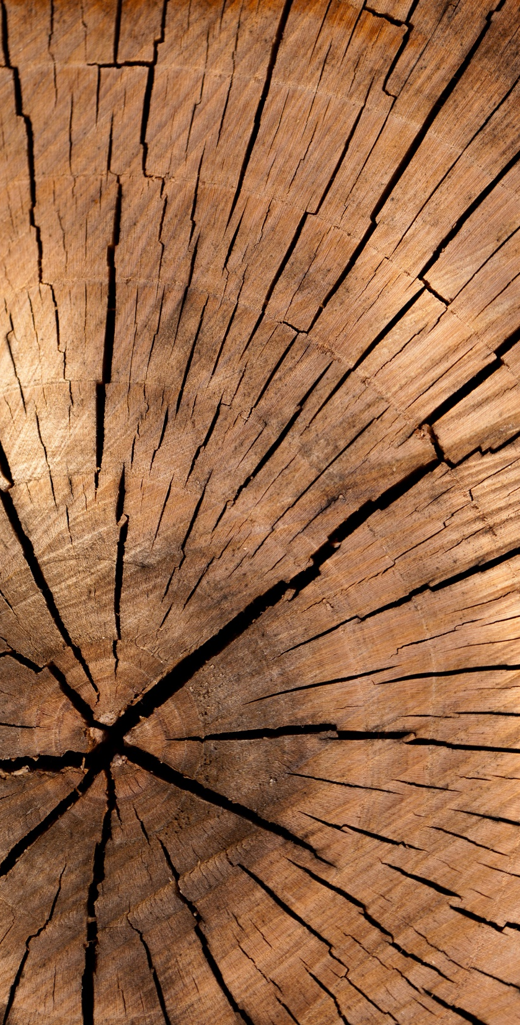
introduction
Woods can be classified into 3 main groups;
Softwoods
Hardwoods
Manufactured Boards.

Slide 4
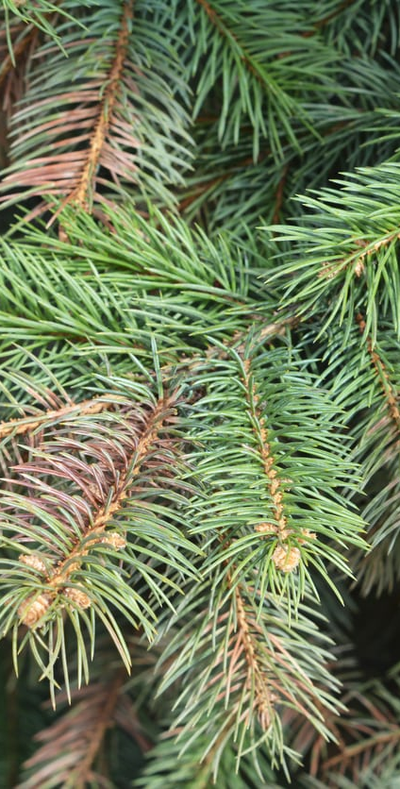
softwoods
These come from coniferous trees (trees that have needle-like leaves and last throughout the year)
These grow quickly and can be replaced quickly after being cut down.
Softwoods are relatively cheap to buy.

Slide 5
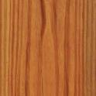
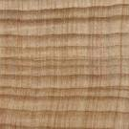
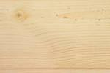

Name | Properties | Uses | Cost
Red Pine | Straight grained, but knotty, quite strong and easy to work. Red/orange in colour | Building construction. Needs good protection when used outside. | Low
Parana Pine | Straight grained with few knots. Quite strong and durable but warps easily. | High quality interior construction and furniture. | High
Spruce (whitewood) | Quite strong with few knots. Resistant to splitting but not durable. | Fitted furniture e.g. Kitchen cabinets. | Low
Cedar | Straight grained and knot free. Very light and durable. Quite soft | Shed construction and good quality fencing. | High

Slide 6
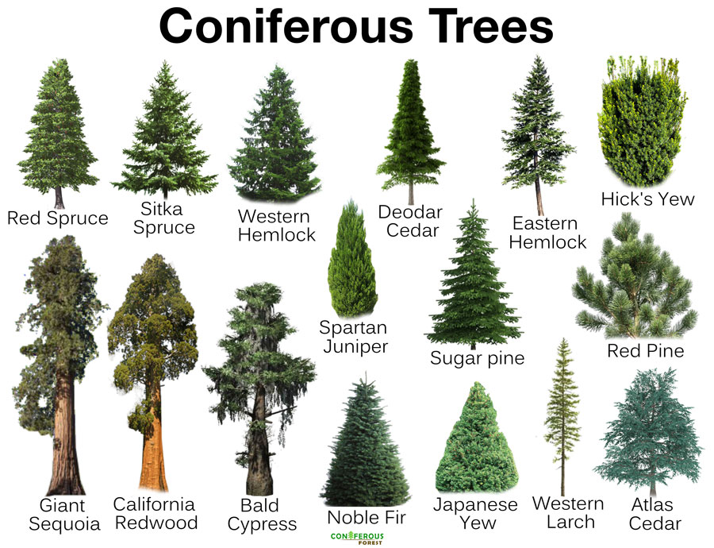

Slide 7
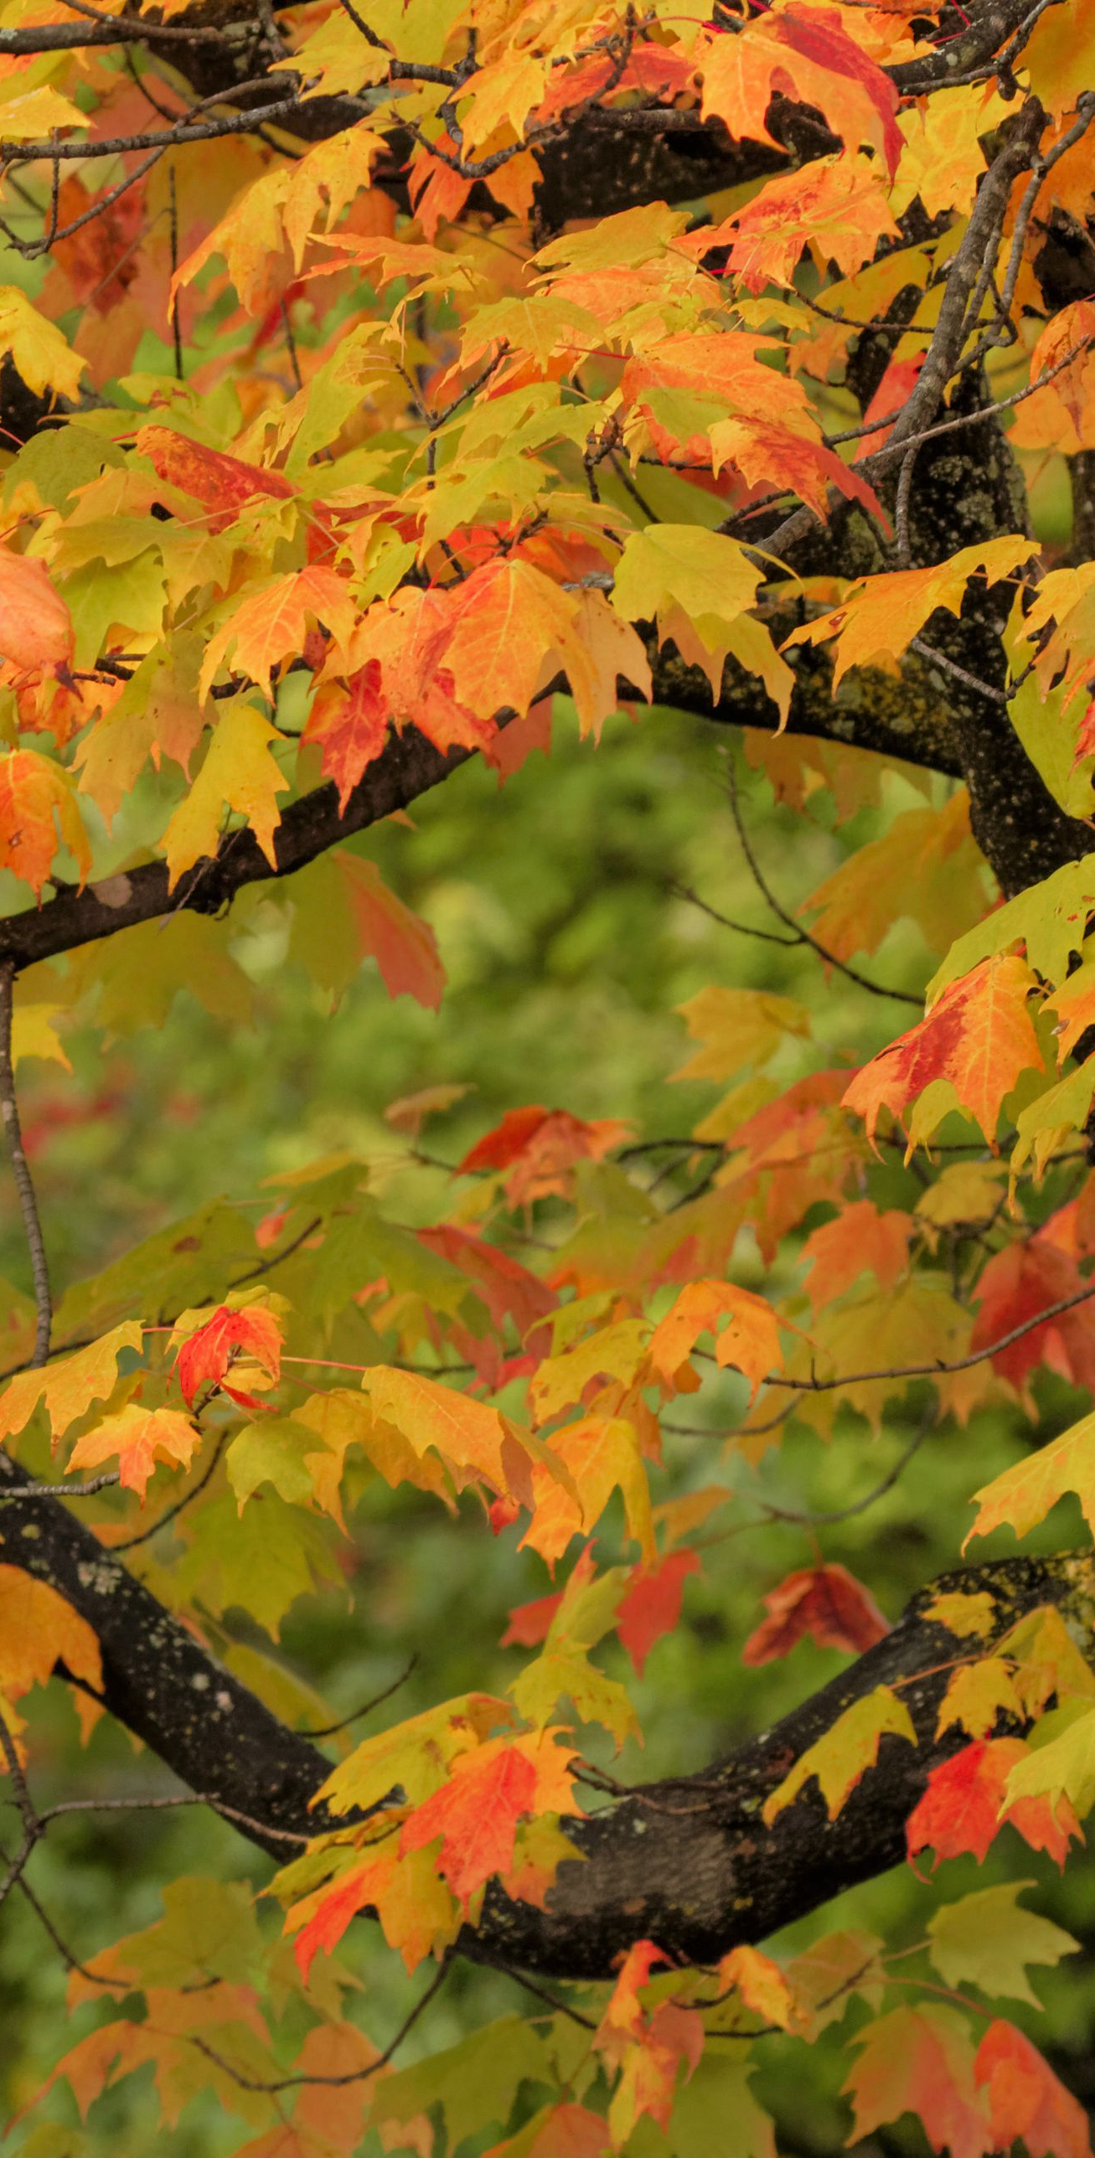
hardwoods
These come from deciduous trees (trees that lose their leaves every winter).
They grow slowly and sometimes have twisted trunks.
They are often not replaced when cut down and take a long time to grow.
Their wood is expensive and used for high quality products.

Slide 8
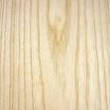
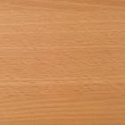
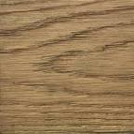

Name | Properties | Uses | Cost
Ash | Light in colour, flexible, tough bends well and varnishes well. | Tool handles, cricket/baseball bats, snooker cues, ladders and veneers. | Med
Beech | Mid-brown colour, hard, strong, tough, tends to warp but bends well. | High quality furniture, toys, tool handles and veneers. | Med
Oak | Light brown, hard, tough, heavy and durable outside. Gets harder with age. | high quality furniture, garden furniture, boats and veneers. | High
Mahogany | Red in colour, medium weight, quite strong, durable but warps easily. | high quality furniture, shop furniture, boat fittings and veneers. | High

Slide 9
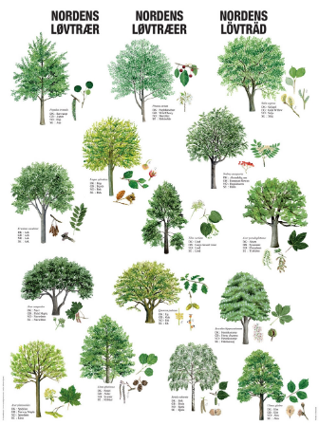

Slide 10
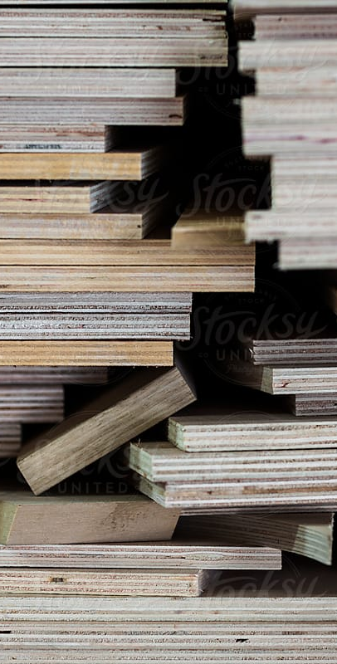
Manufactured boards
These are made from waste wood left over from machining or working. All excess such as thin sheets (plywood), small strips/blocks (blockboard), wood chips (chipboard) and saw dust (MDF) are used to make boards.
Manufactured Boards are used to manufacture furniture due to the material being available in large sheets and because it does not warp.

Slide 11
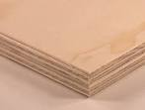
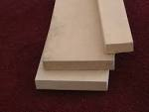
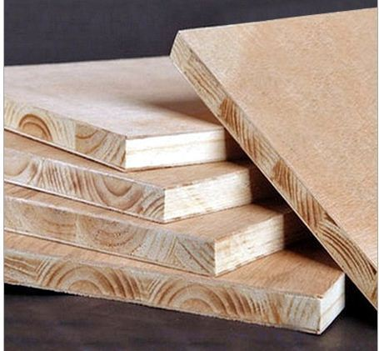
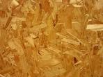
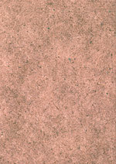
Name | Properties | Uses | Cost
Plywood | Strong, stable, warps easily. Made by gluing layers of thin sheet wood together. It is important that the grain of each layer goes in a different direction to ensure maximum strength. | Bases of drawers or boxes. Backs of cabinets and wardrobes etc. | Med
MDF | Very strong and doesn’t warp. Made from gluing and tightly compressing excess sawdust together. | Furniture and toys. | Med
Blockboard | Very strong and rigid and doesn't warp. Very heavy. Made from gluing strips/blocks of wood together. | Quality furniture, stage flooring and fire doors. | High
Chipboard | Heavy, warps easily and needs a good finish. Made by gluing and tightly compressing wood chips together. | Kitchen cabinets and worktops, roofing boards. | Low
Hardboard | Not very strong, warps easily and needs a good finish. Made similar to plywood. | Door panels, drawer bottoms and cabinet backs | Low

Slide 12
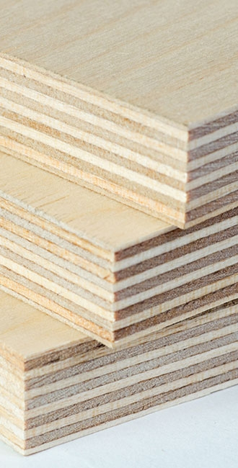
plywood
An engineered sheet timber comprised of three or more thin layers of wood veneer (plies) that are glued together to form a thicker, flat sheet.
The plies are glued together at 90° to each other.
Plywood is a very versatile product, used for a range of structural, interior and exterior applications.
Your S2 box design was made of plywood.

Slide 13
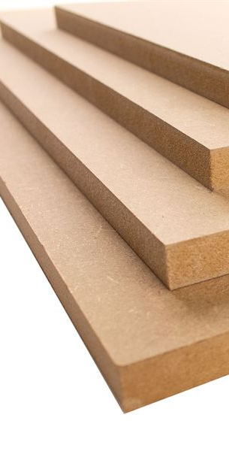
MDF
MDF stands for medium-density fiberboard.
It is manufactured from broken down hardwood and softwood into fibres and combined together with a wax or resin to form panels.
This is achieved by combining the fibres and resin at high pressure and temperature.
MDF is commonly used for furniture, flooring, cabinetry, fire resistance, soundproofing etc.

Slide 14
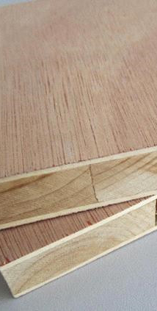
blockboard
Blockboard consists of a core of wooden strips sandwiched between two layers of plywood.
It is used to make doors, tables, shelves, partition walls and panelling, amongst other things.

Slide 15
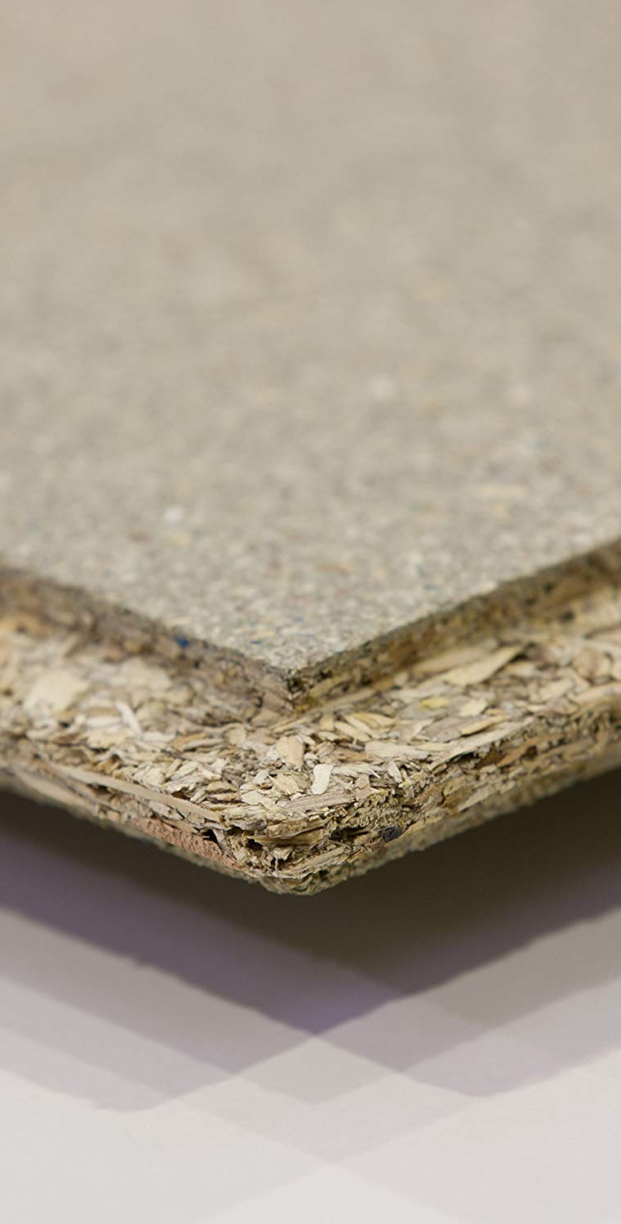
chipboard
Chipboard is sometimes referred to as particle board or low-density fibreboard.
It is manufactured by mixing small wood particles with epoxy resin, which are pressed together under intense heat and pressure to produce a rigid board, typically with a smooth surface.
Chipboard is commonly used for floors, furniture and kitchen worktops etc.

Slide 16
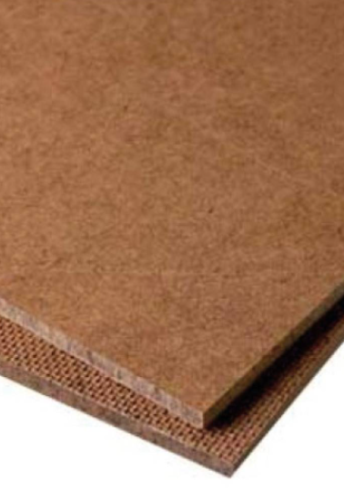
hardboard
Hardboard, also called high-density fiberboard (HDF) is a type of fiberboard, which is an engineered wood product.
It is used in furniture and in the construction industry. You will often find it as drawer bottoms or back panelling of wardrobes etc.
One side is smooth whilst the underside has a rougher texture.

Slide 17
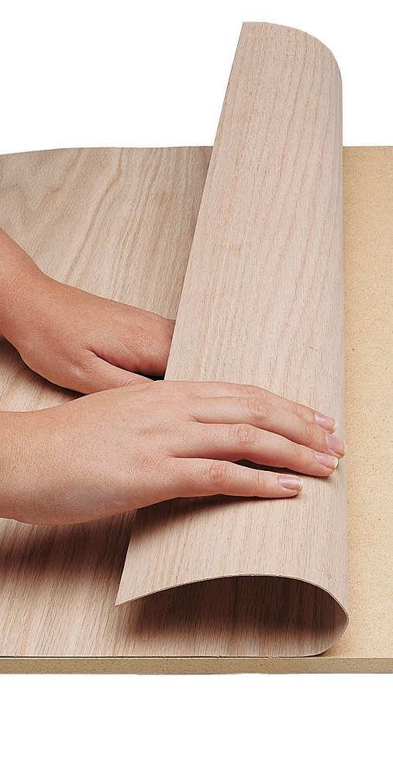
veneer
A veneer is a thinly cut layer of fine grain wood placed on top of a coarser piece of wood.
For example:
It is used to give the appearance of an expensive hardwood wood over, for example, a manufactured board or cheaper softwood.

Slide 18
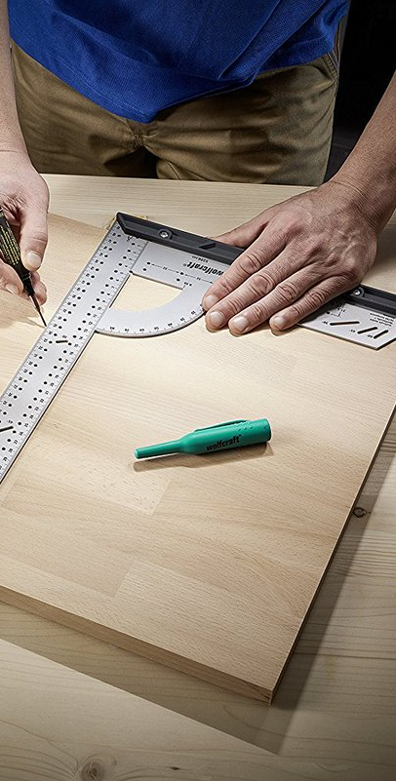
Marking out tools
Before you start making anything in the workshop, you will need to mark out any wood working joints and waste wood onto your wood.
We use many different marking out tools to do this...

Slide 19
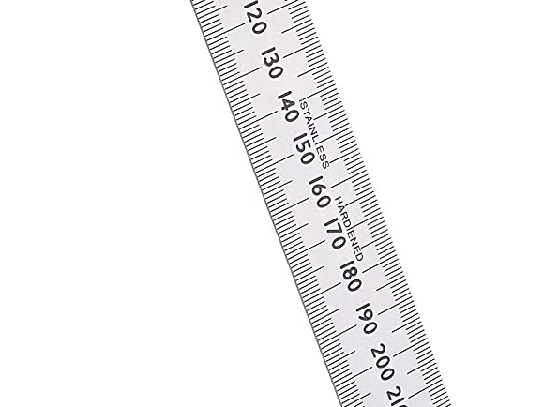
Steel rule
For measuring sizes on wood, metal and plastic.
The “0” of the steel rule starts right at the edge.
Sizes are in mm.

Slide 20
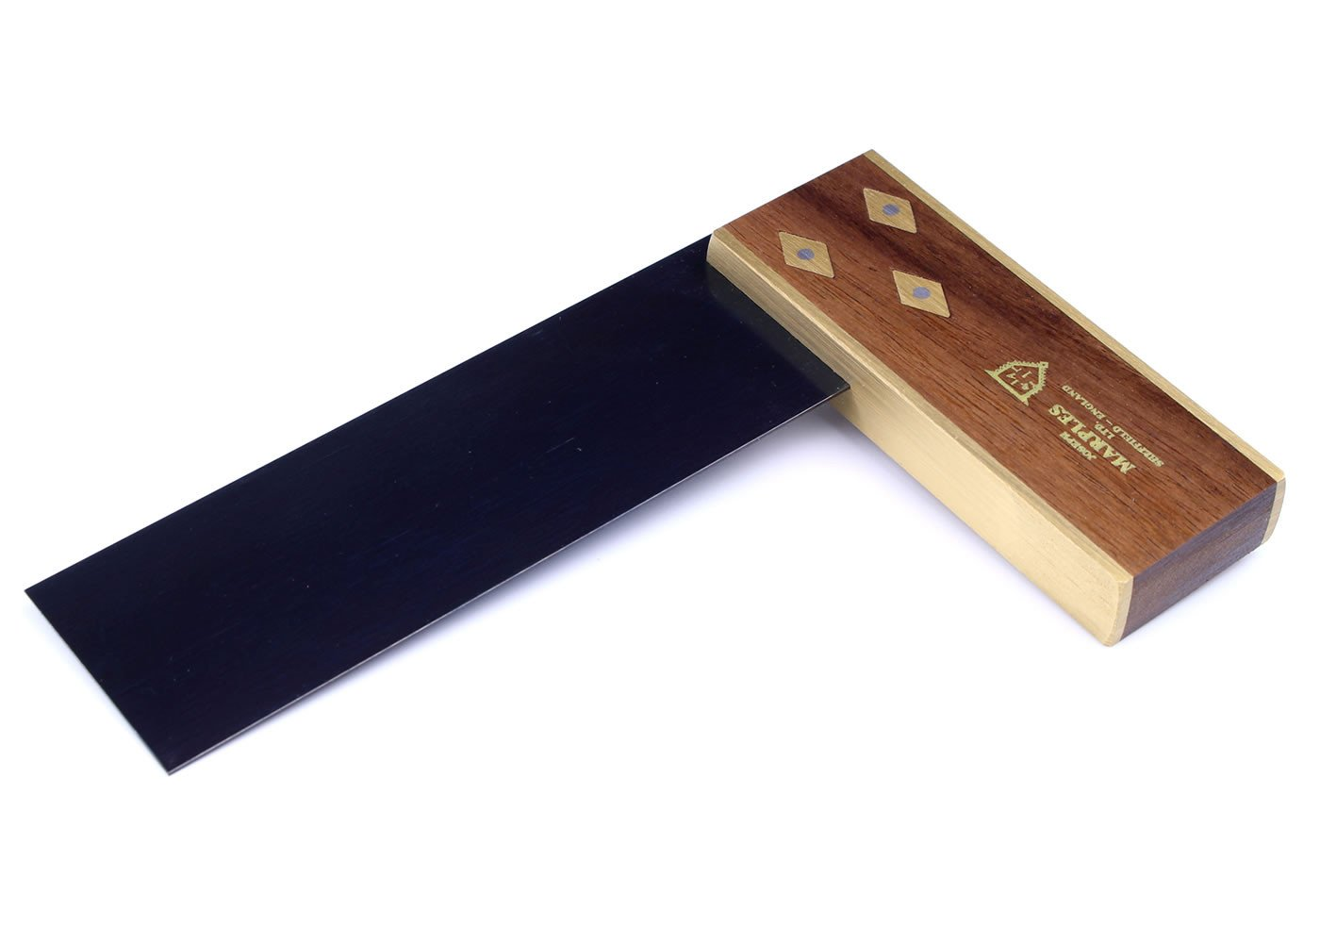
Try Square
For marking lines at right angles (90 degrees) to an edge of a piece of wood.
Always ensure the brass section is flush against the edge of the wood to ensure a perfect right angle.

Slide 21
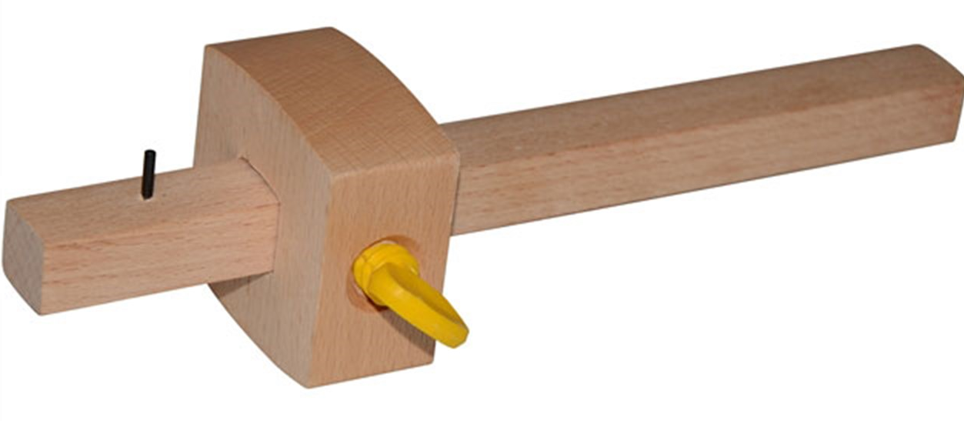
Marking gauge
For marking lines parallel to an edge of a piece of wood.
Stock
Spur
Stem
Thumb Screw

Slide 22
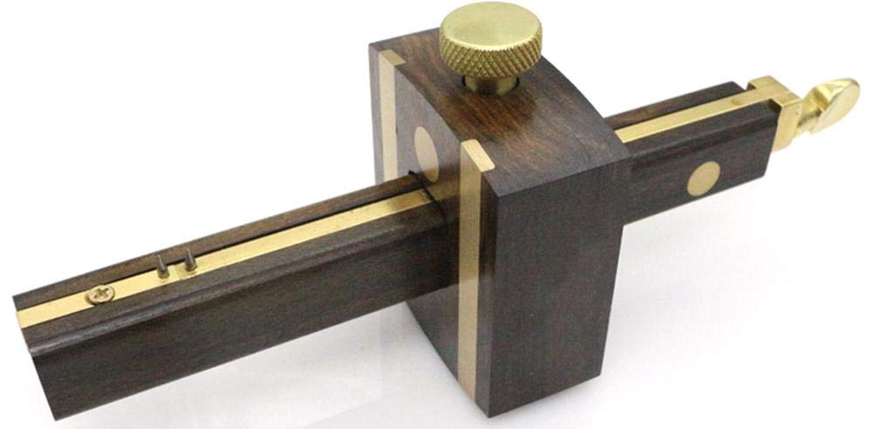
Mortise gauge
For marking out the width of a mortise hole for a mortis and tenon joint.
Thumbscrew
Stock
Adjustable Spur
Fixed Spur
Adjustment Screw - Adjusts width of the mortise joint.
Stem

Slide 23
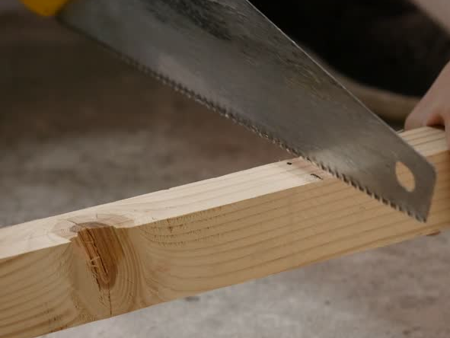
Cutting and shaping tools
Once you have finished marking out your job it is time to think about what tools you will need to cut and shape your work.
It is important to note that there are two categories of Saw: Rip Saws and Cross-cut Saws.
Rip Saws are used for cutting along the grain. Cross-cut saws are used for cutting across the grain.

Slide 24
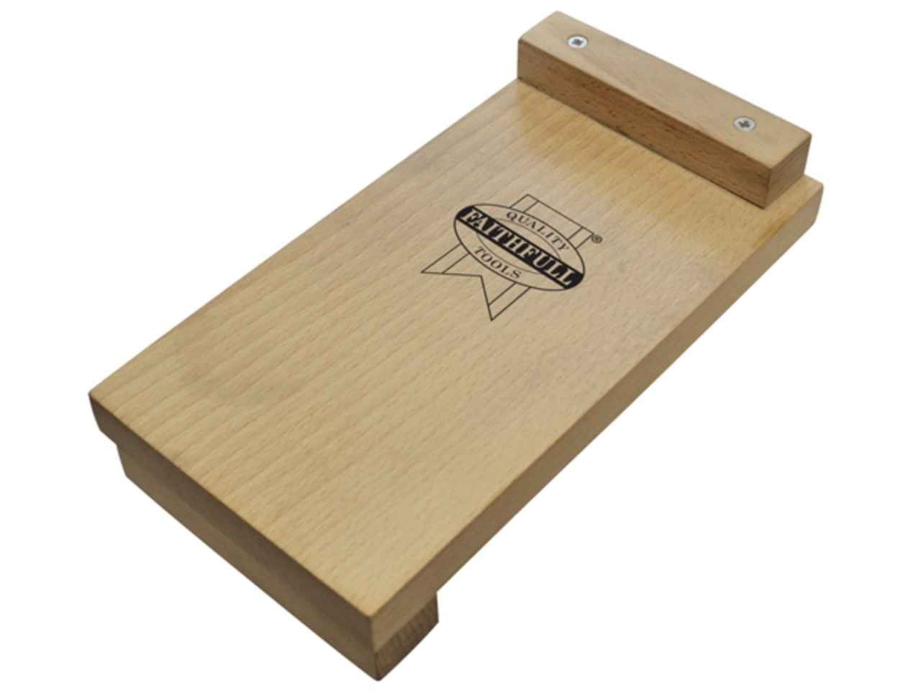
Bench hook/ sawing board
A bench hook is an aid to crosscutting small pieces of wood on the bench.
As well as helping you to hold the wood in place, it also supports the wood - particularly the small piece that is about to fall off when you've finished cutting.

Slide 25
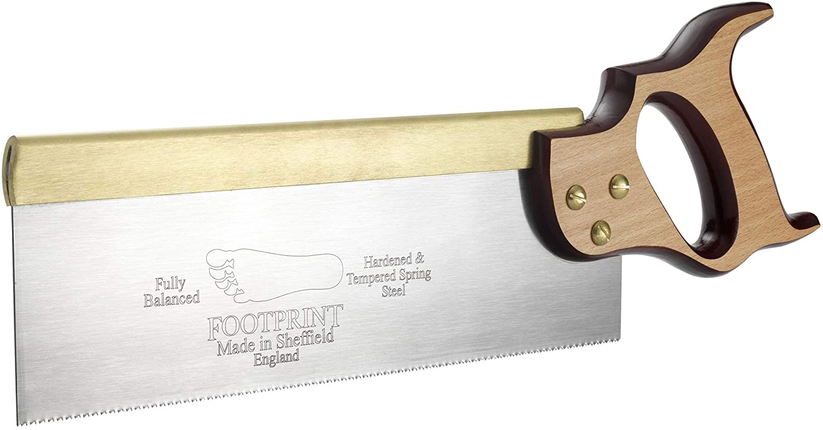
Tenon saw
Mainly used for cutting out joints in wood. This saw cuts very straight because the blade is very rigid (stiff) due to brass back at the top of the saw. (Cross-Cut Saw)

Slide 26
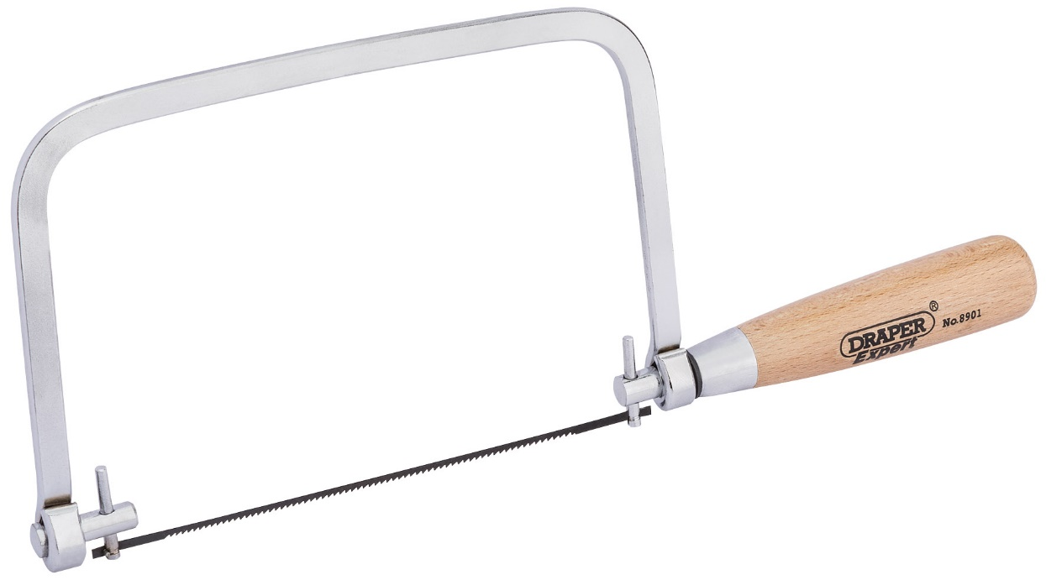
coping saw
A thin saw used for making curved cuts.
The blade can be set to almost any angle and is very flexible but can break easily so care and attention must be taken.

Slide 27
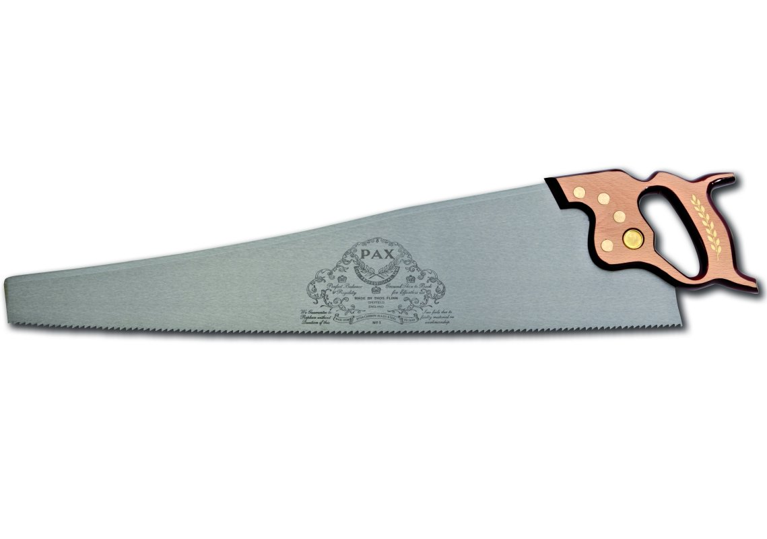
panel saw
Mainly used for making straight cuts in large pieces of timber. (Rip Saw)

Slide 28
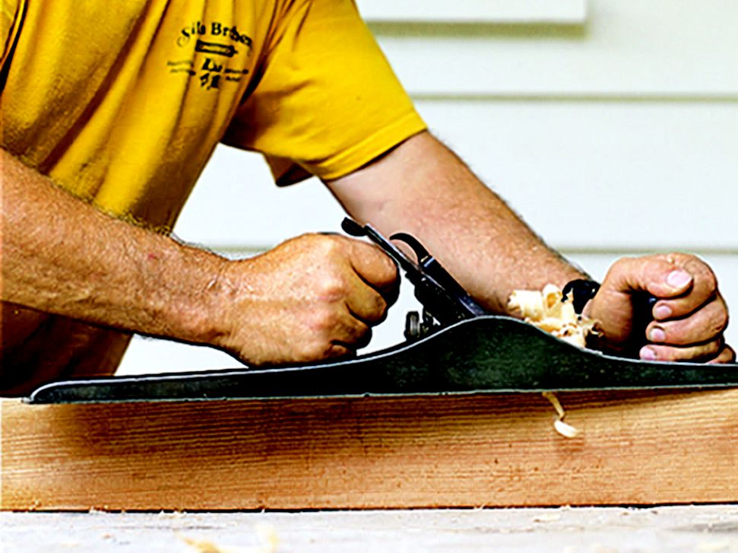
planes
Planes are used to flatten or reduce the thickness of timber. They can also be used to smooth the surface.
Plane Safety
Always ensure that the blade is set correctly to ensure that there is no risk of accident or damage to your wood/plane. Always place your plane side up on the work bench to ensure that the blade does not get damaged.

Slide 29
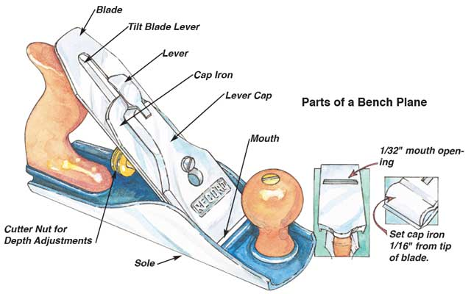
Smoothing & jack plane
Although both Jack and smoothing planes look similar they are used for different jobs:
Jack planes are used to make long edges straight and square and are longer than smoothing planes.
Smoothing Planes are used to make surfaces smooth.

Slide 30
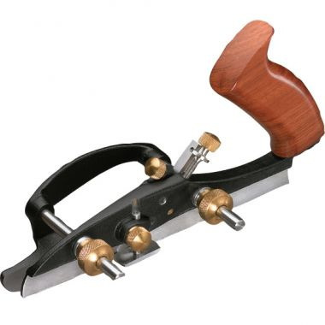
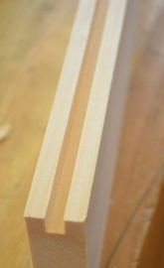
Plough plane
Used for cutting grooves on the inside face of a piece of wood.
The depth of the cut can be set by adjusting the blade and the width from the edge of the wood can be adjusted by setting the fence of the plane.
Example cut:

Slide 31
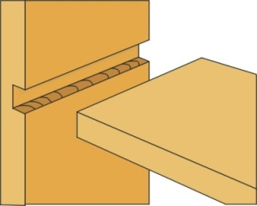
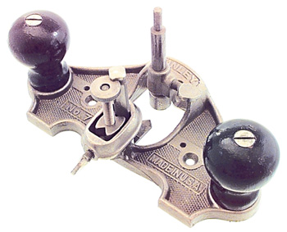
router plane
Example of cut made
Used for cutting or
tidying joints such as a housing joint.
Blade
Blade
Adjustment
Screw

Slide 32
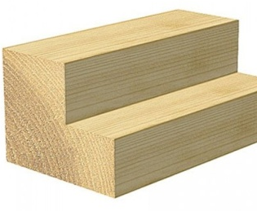
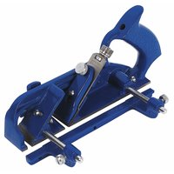
rebate plane
Used for cutting grooves on an edge of a piece of wood.
Example of cut made

Slide 33
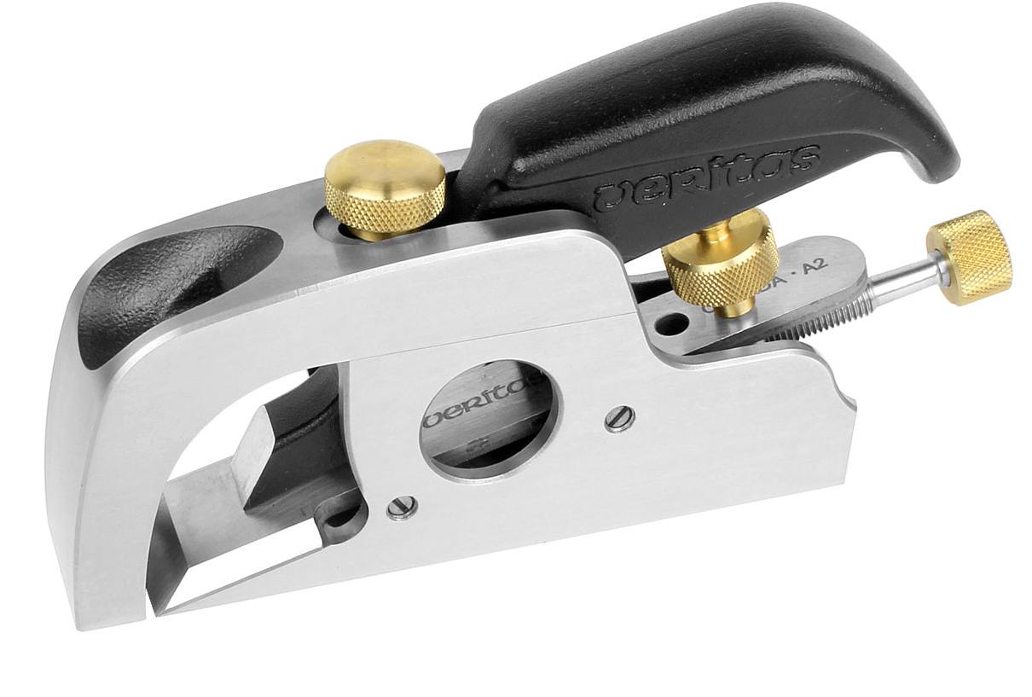
bullnose plane
The shoulder plane has a blade flush with the edges of the plane, allowing trimming right up to the edge of a workpiece. Is also used to plane the end grain of wood due to the shallower blade angle.
Blade Adjustment Screw
Blade

Slide 34
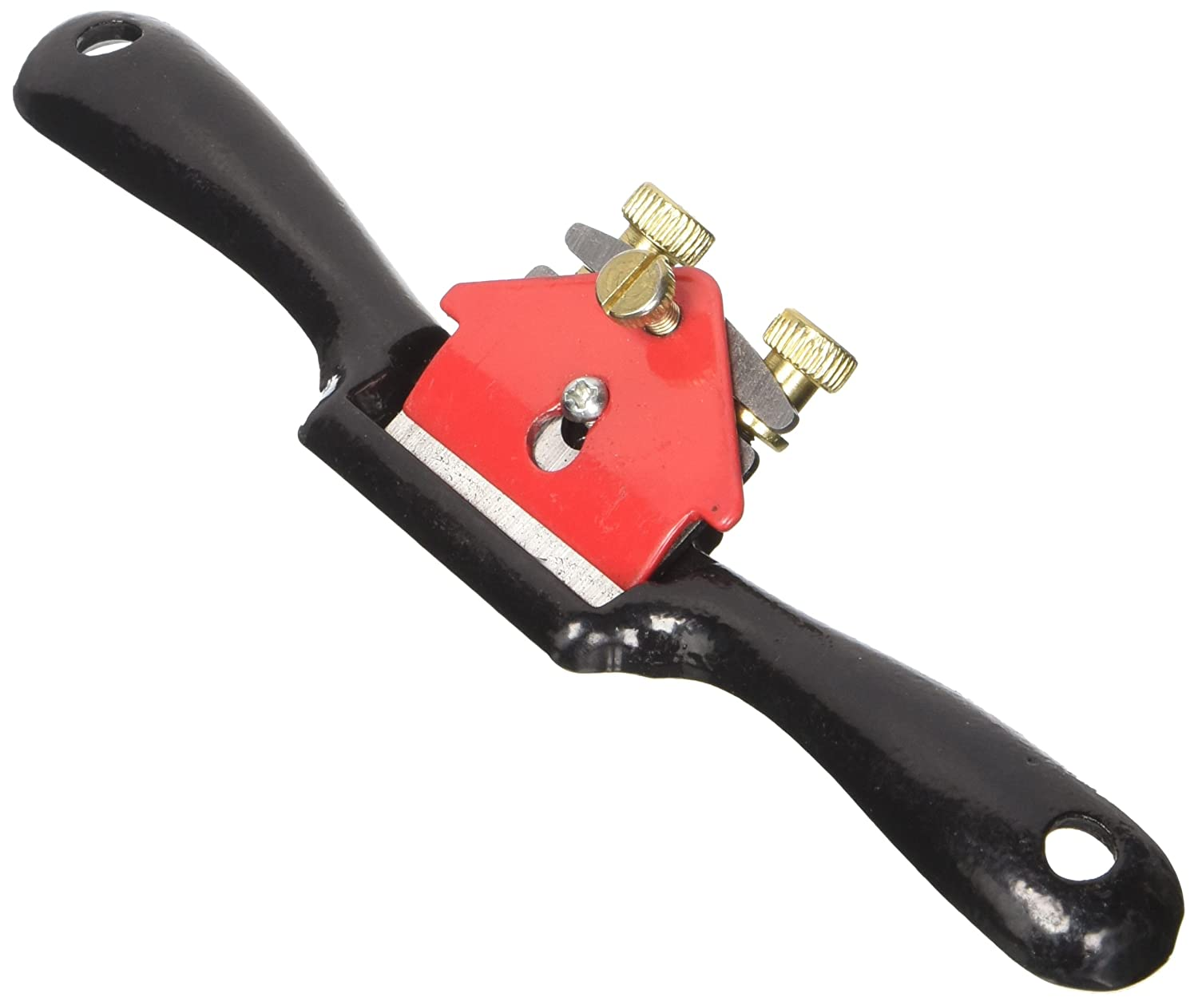
spokeshave plane
Blade Adjustment Screw
A spokeshave is a tool used to shape and smooth wooden rods and shafts – often used to make wheel spokes (not so much now, as there is not much demand for wooden wheel spokes), chair legs etc – also used to shape curves etc.
Blade

Slide 35
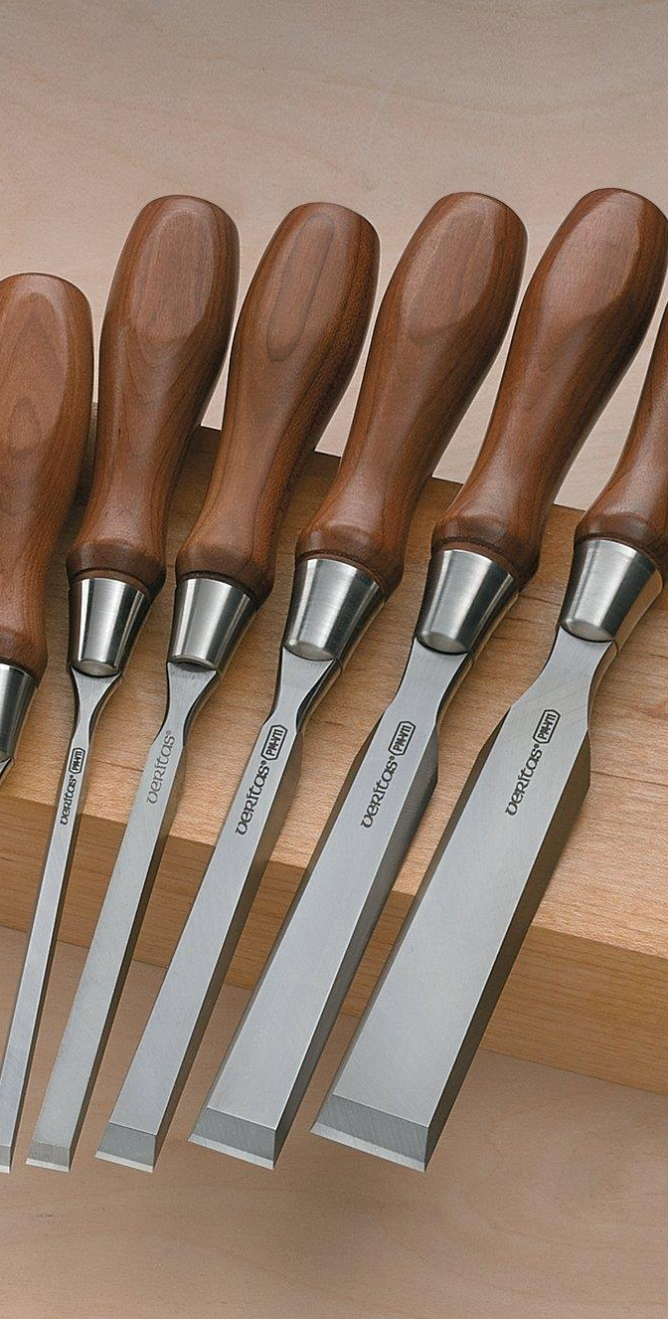
chisels
Chisels consist of a blade and a handle, used to accurately cut and shape wood.
The handle on a chisel is normally made from Ash, which is a very strong hardwood, or polycarbonate plastic so that it will offer resistance from splitting when being hit with the mallet. Wooden chisels will always have some type of ferrule that helps stop the wood from splitting this is normally a metal ring on one or both ends of the chisel’s handle.

Slide 36
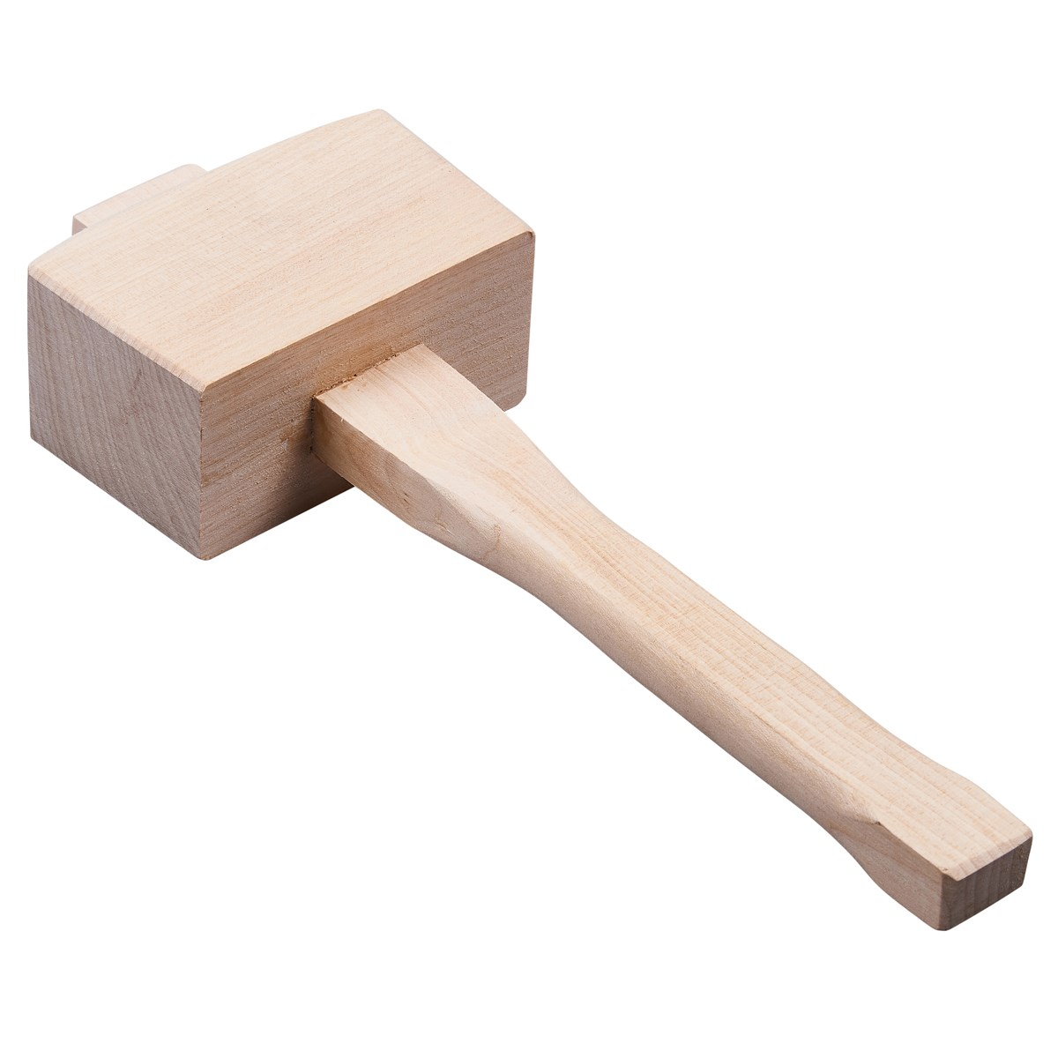
beech/wooden mallet
This is not a chisel but it is used along with chisels. The wooden mallet is used for hitting the handle of a chisel and driving it through a piece of wood to cut out waste wood.

Slide 37
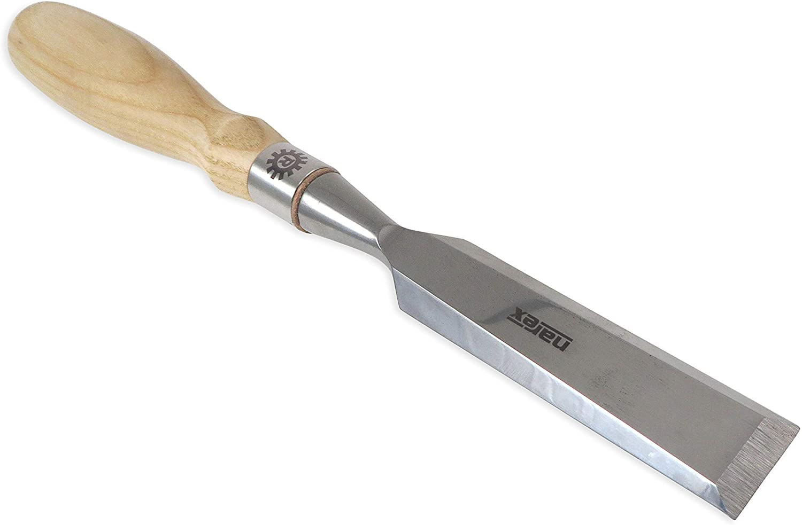
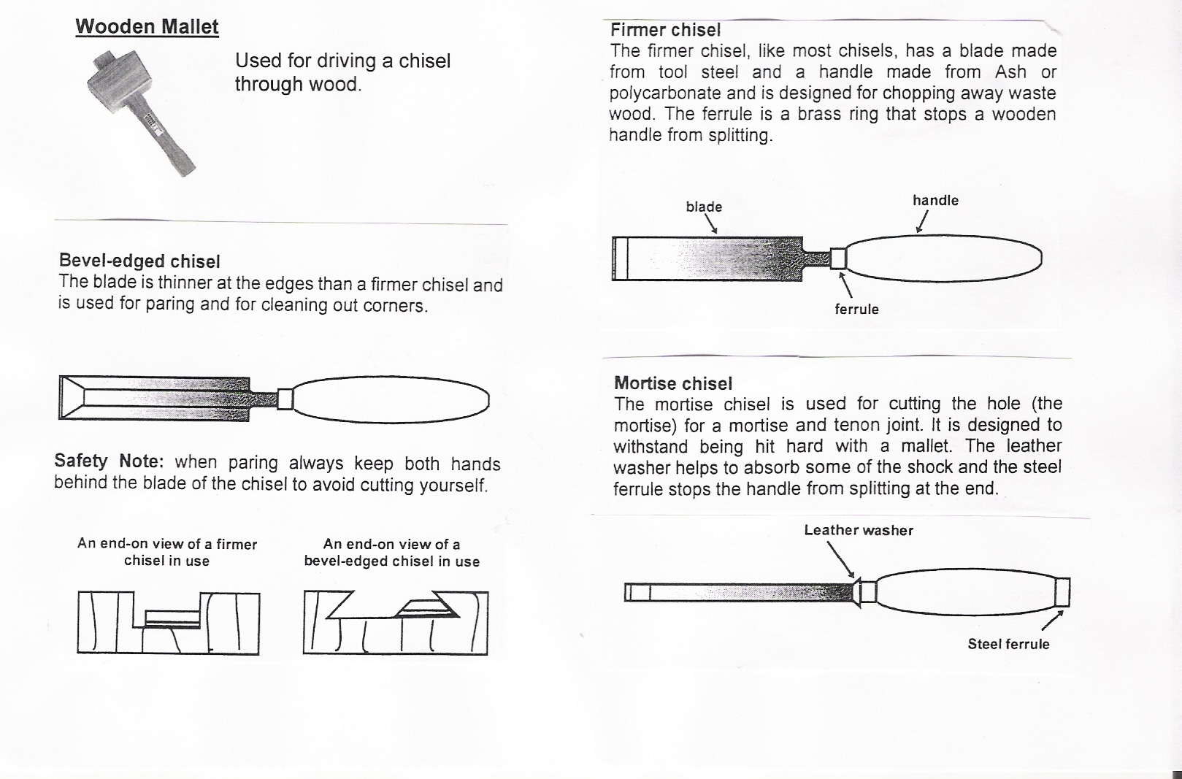
Bevel-edged chisel
The blade is sloped at the edges. This chisel is normally used for pairing wood or cleaning/tidying up joints.
Due to the blades having sloped edges it makes them easy to push into corners. They are often used for finishing dovetail joints.
End view of a bevel-edge chisel in use.

Slide 38
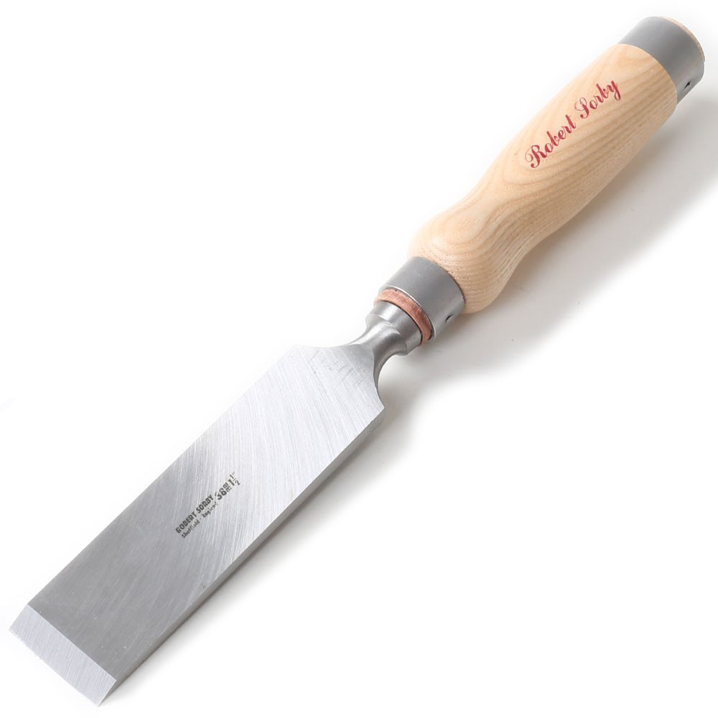
firmer chisel
Firmer chisels have straight sides which means that they are stronger and can be used for tougher/ heavier work.
End view of a firmer chisel in use.

Slide 39
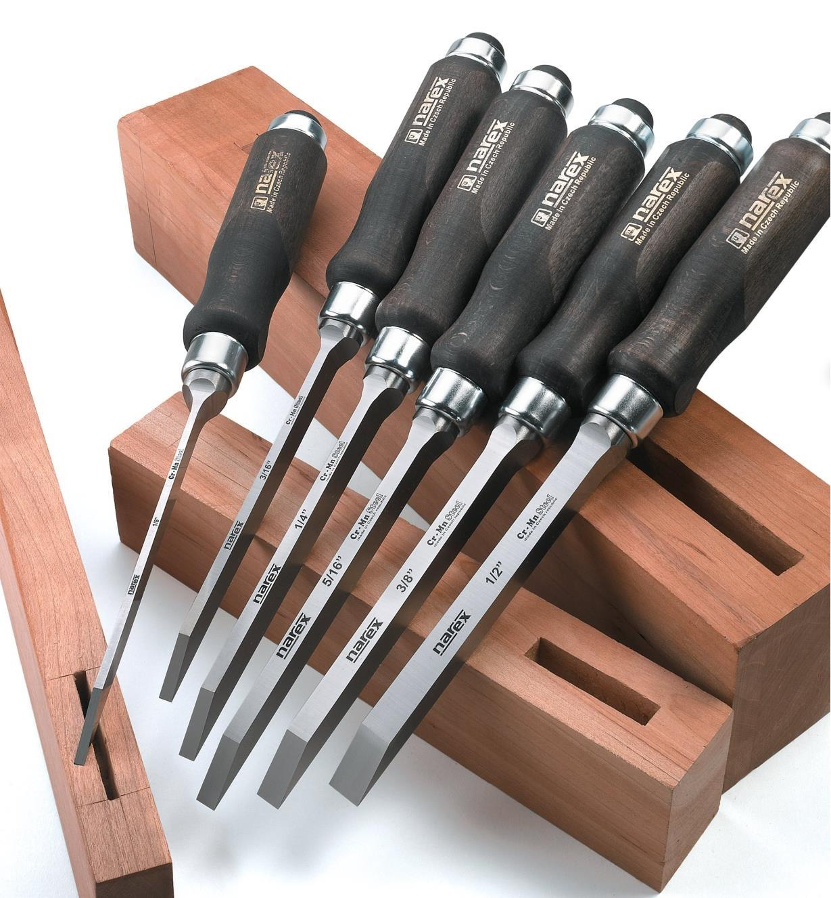

mortise chisel
Used for cutting the mortise (hole) in a
mortise & tenon joint.
Mortise hole
Mortise hole

Slide 40

templates
Using a template for woodwork offers several benefits, including:
Accuracy: allows the dimensions and shapes to be accurately transferred onto the wood, plastic or metal.
Time-saving: allows you to quickly produce the drawing on the work piece without having to measure and mark out with other tools.
Reproducibility: templates allow you to replicate the drawing multiple times.
Consistency: templates allow each piece to be drawn the same, ensuring that every work piece is identical, particularly for repeated items or more complex pieces.

Slide 41

Timber joints
The majority of joints used in woodcraft have been designed specifically to attain the maximum possible strength in the model they are holding together.
The type of joint selected will depend on what is being constructed i.e. what forces are going to be exerted upon the artefact.
The selection is also dictated by the final appearance. i.e. in furniture manufacture it is normally important to hide the joint, as a piece of furniture which has a strong joint construction but if the joints are showing it will not be very pleasing to look at and ultimately potential customers would most likely avoid buying such furniture.

Slide 42

Wood joints
You will be shown an image of a wood joint.
Can you name the type of joint?
Some of these you have already made, for example:
The sides of the spice rack in S1.
The base of the mug tree in S2.
YOU MUST KNOW HOW TO MARK OUT AND CUT THESE JOINTS FOR THE EXAM!
YOU MUST MAKE MENTION OF THE TOOLS USED AND EXPLAIN HOW TO CUT AND SHAPE THE JOINTS IN DETAIL.

Slide 43

Butt joint
Butt joints are the quickest and simplest to make but are not very strong.
They generally need dovetail nailing to increase the overall strength of the joint.

Slide 44

Dowelled joint
These joints are both neat and strong.
The holes must be lined up exactly but this can be done using a dowelling jig.
The dowel will have a groove in the length so as to allow excess glue to escape.

Slide 45

Corner halving joint
This joint is stronger than the butt joint and is also simple to make, but still needs strengthening with screws or dowels.

Slide 46

Corner bridle joint
This joint is strong and fairly easy to make. They can be strengthened by dowels.

Slide 47

Through mortise and tenon joint
The mortise & tenon joint is the strongest tee joint and can be further strengthened by wedging or dowelling.

Slide 48

Haunched mortise and tenon joint
This joint is used where the rail of a table will join into the top leg of the table.
This could be regarded as a hidden joint and it offers resistance to twisting.
Haunch

Slide 49

Dovetail joint
This type of joint is very strong and can be only pulled apart in one direction. It is mainly used to construct drawers.

Slide 50

Through housing joint
These joints are simple to make and are suitable where the two parts being joined together are the same width.

Slide 51

Stopped housing joint
These are harder to make, but are neater because the joint does not show on the front edge.

Slide 52

Flat pack
In today’s society, people want furniture that is cheap and easy to move.
With more and more people living in flats and apartments it is difficult to haul large pieces of furniture up flights of stairs and through tight doors.
Ikea is one of the most successful producers of flat packed furniture that comes in boxes which makes it easier for people to manoeuvre new furniture into their homes.

Slide 53
Flat pack
The only downside is that they have to put the furniture together once it is in their homes and they do not often have the tools that a Joiner would have to make the joins from the previous slides.....
Benefits of flat-pack furniture for the manufacturer are the reduced storage and the reduced cost due to not having to assemble the furniture.
Benefits of flat-pack furniture for the consumer/customer are ease of transportation of the furniture to their homes and furniture which is lower in price than non flat-pack furniture.

Slide 54

Knock down fittings
Knock-down fittings are joints that can be put together easily.
Normally people only need a screw driver, a drill, a mallet/hammer or other basic tools to put them together.
They are temporary joints although many are used permanently to join together items such as cabinets and other pieces of furniture that are purchased in a flat pack.
Common Knock down fittings are: Plastic or wooden corner blocks, Cam lock fittings & Scan fittings

Slide 55

Plastic corner block
The corner block is pressed against the two pieces of material
Screws are used to fix the block into position. This type of joint is used to fit modern cabinets such as those found in a kitchen. It is a relatively strong joint and it has the advantage that it can be dismantled using a screwdriver.

Slide 56

wooden corner block
A piece of material such as pine can be drilled and screws can be passed through these holes.
This gives a cheap and effective knock-down joint. The screws are normally countersunk into the knock-down fitting.

Slide 57


Cam lock fittings
The disk fits into a recess in the first side of the cabinet. It rotates by inserting a screwdriver into the slot in its side. The shaft is screwed into the second side of the cabinet.
The collar of the shaft is passed through the hole in the second slot in the disk. When the disk rotates the shaft is locked in position. This keeps both sides of the cabinet locked together.

Slide 58

Scan fittings
These are strong enough to be either permanent or temporary joints. The cylinder is inserted into the first side of a cabinet in a pre-drilled hole.
The screw is then pushed through the hole in the second side until it meets the cylinder.
It can then be tightened with a screw driver until both sides of the cabinet pull together.

